Slide 1
Part 1: Create Your AWS Training Portal Account

Slide 2
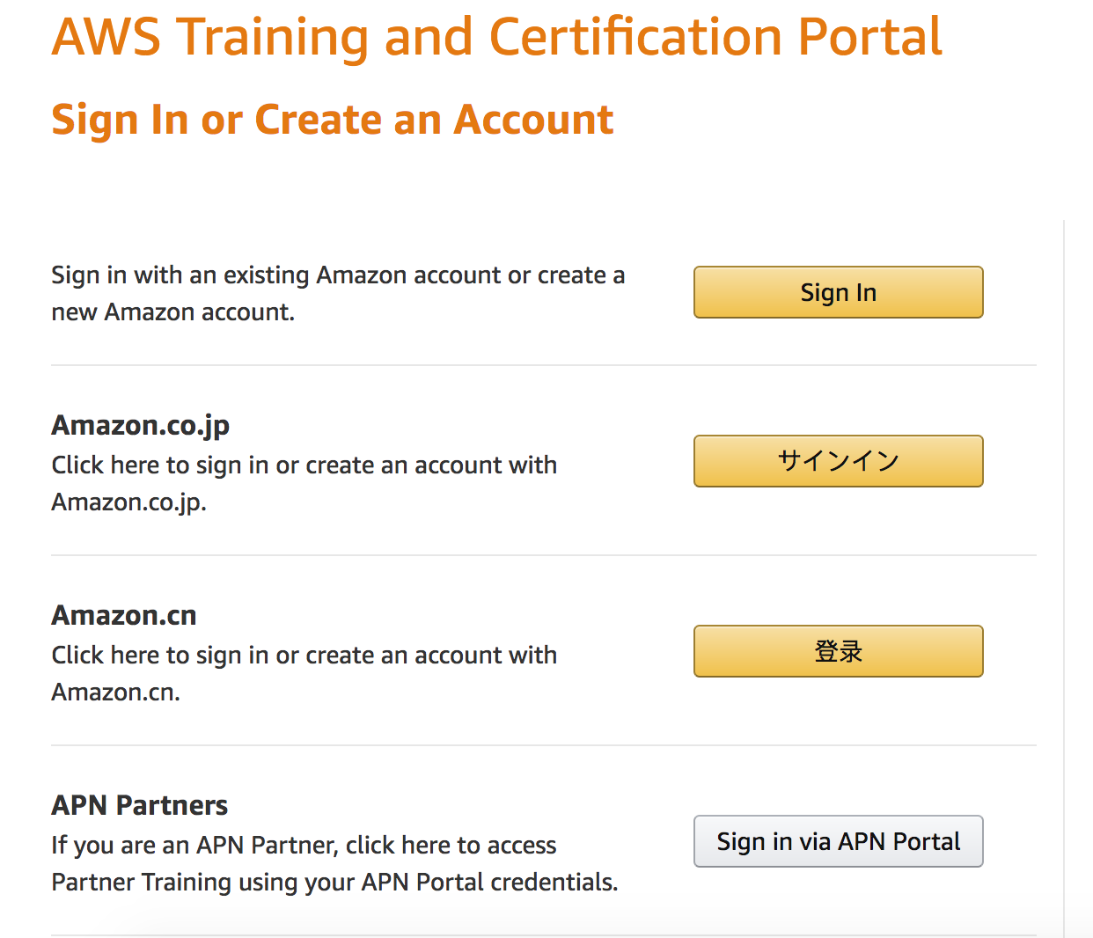
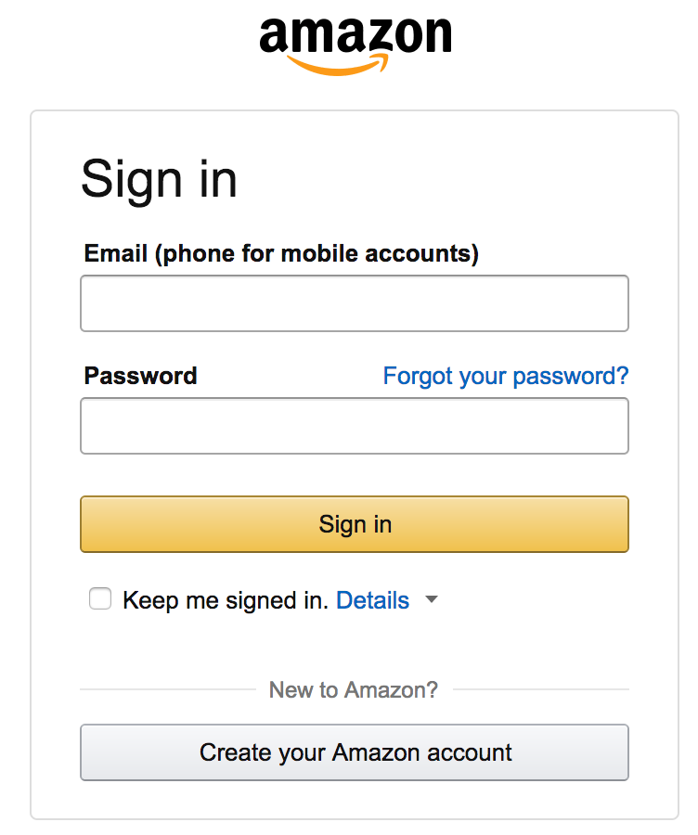
Log in to the AWS Training Portal
Self-registration link provided by your instructor
Click Sign In or Create an Account
Use your existing Amazon.com account or create a new one

Slide 3
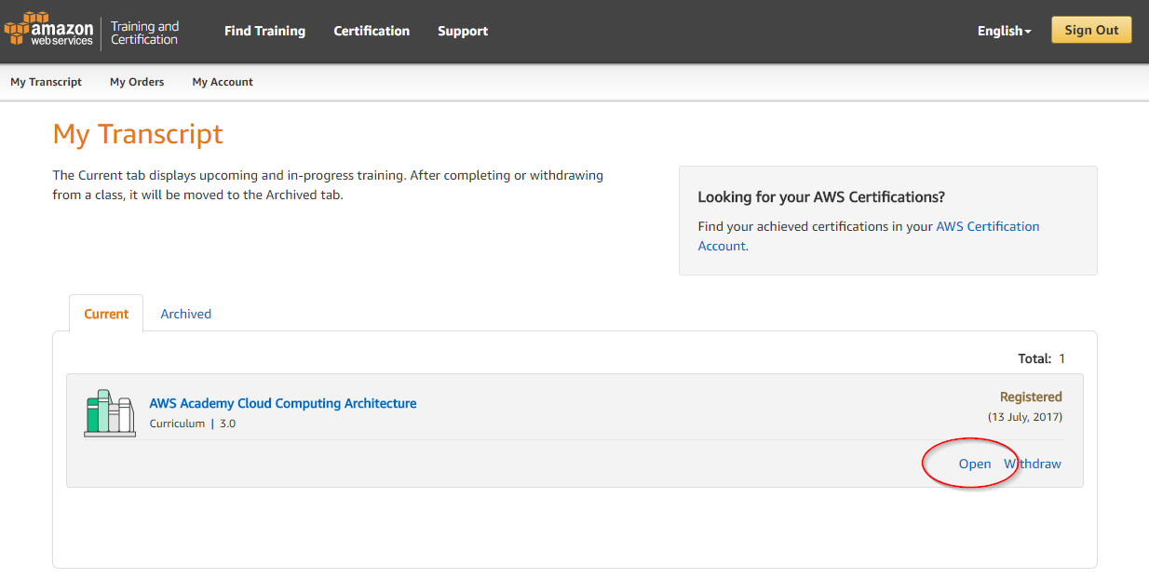
Accessing Curriculum Content
Always available within the My Transcript tab
Click Open to see curriculum components

Slide 4
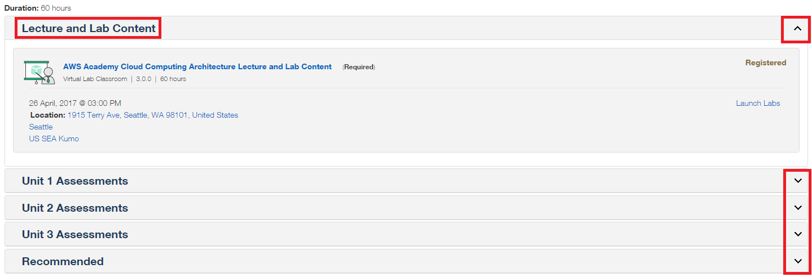
Accessing Lecture and Labs Content
Curriculum includes lectures lab content, and assessments
Sections can be collapsed or expanded

Slide 5
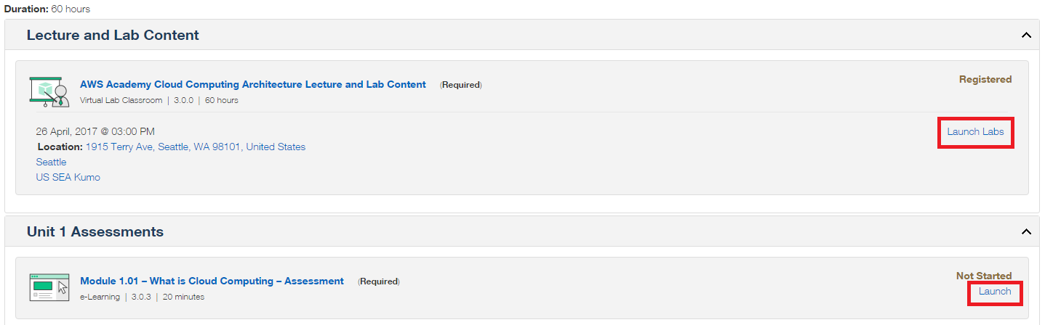
Navigating the Curriculum
To access lecture and lab material, click the Launch Labs button
To access assessments, click Launch

Slide 6
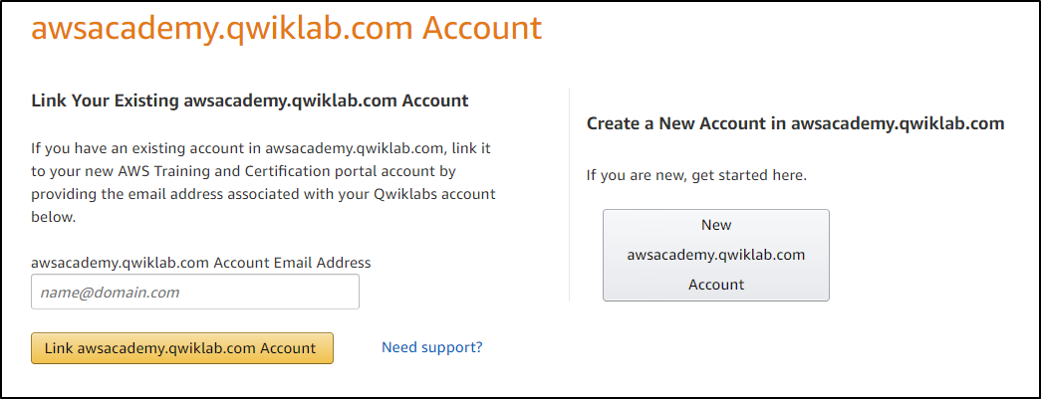
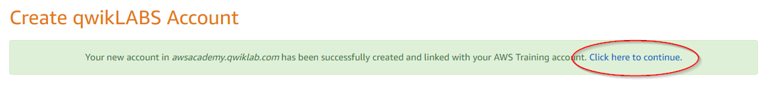
Accessing Lecture and Labs Content
Click Create new account in awsacademy.qwiklabs.com
Note: You only need to do this the first time you open the training portal. Thereafter, you’ll be redirected.

